Slide 1
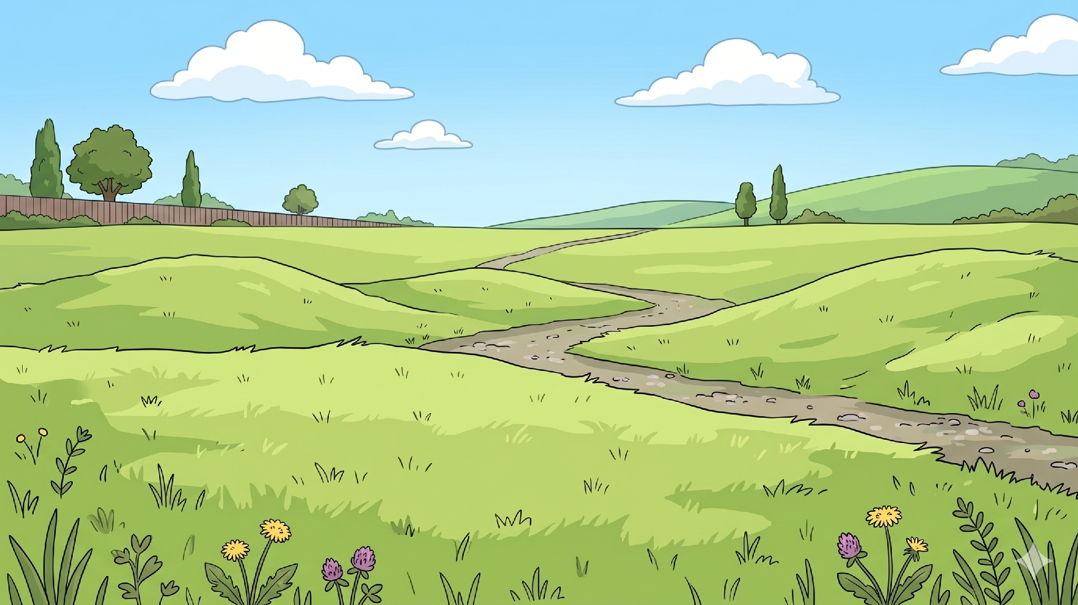
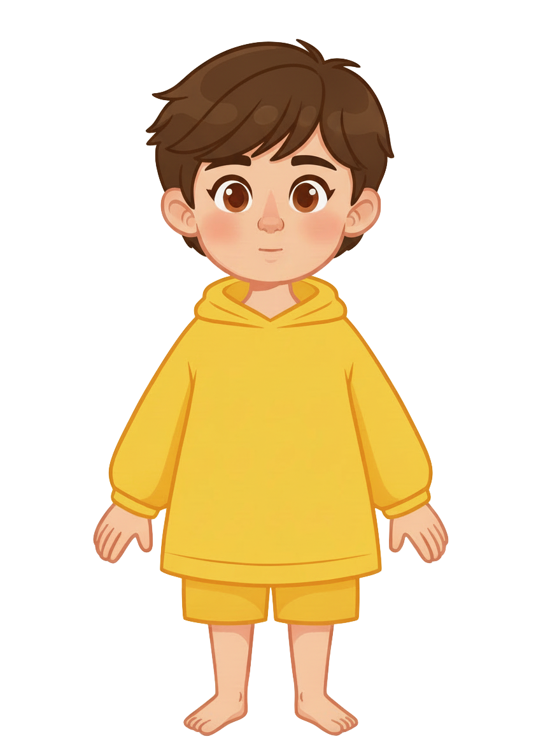
This is Sam.

Slide 2
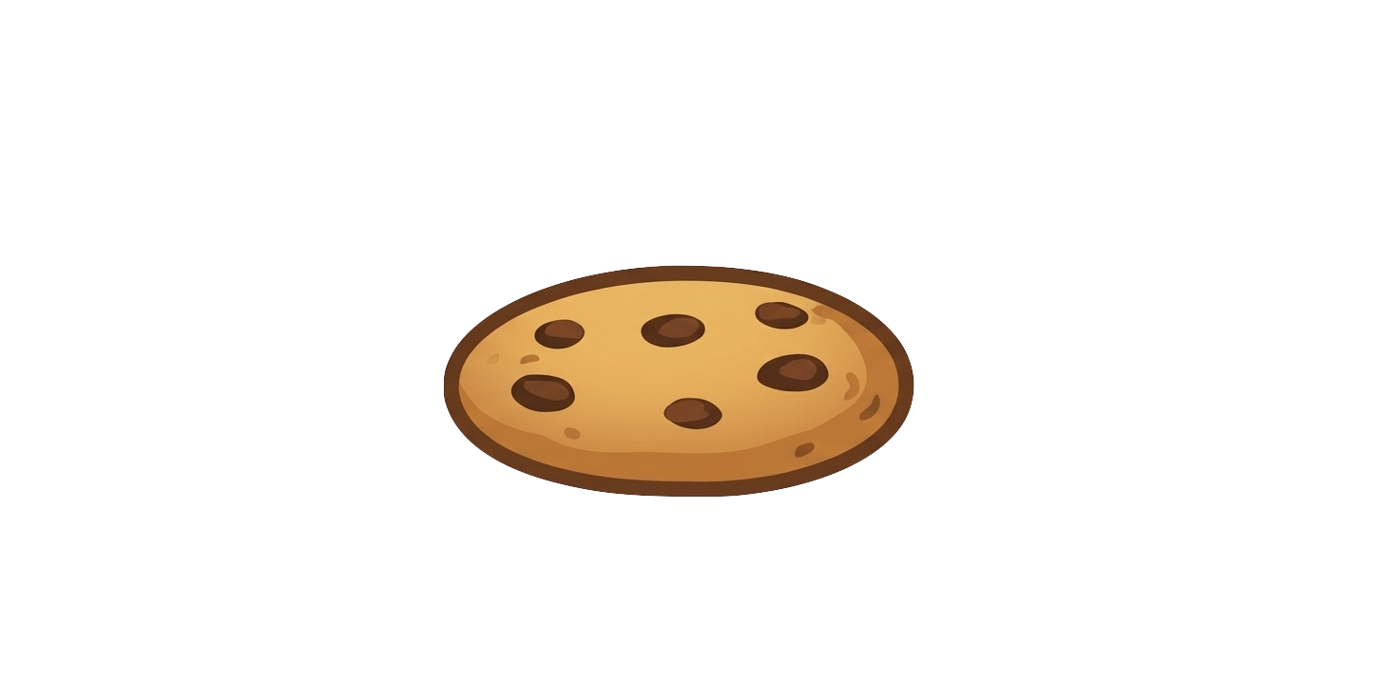
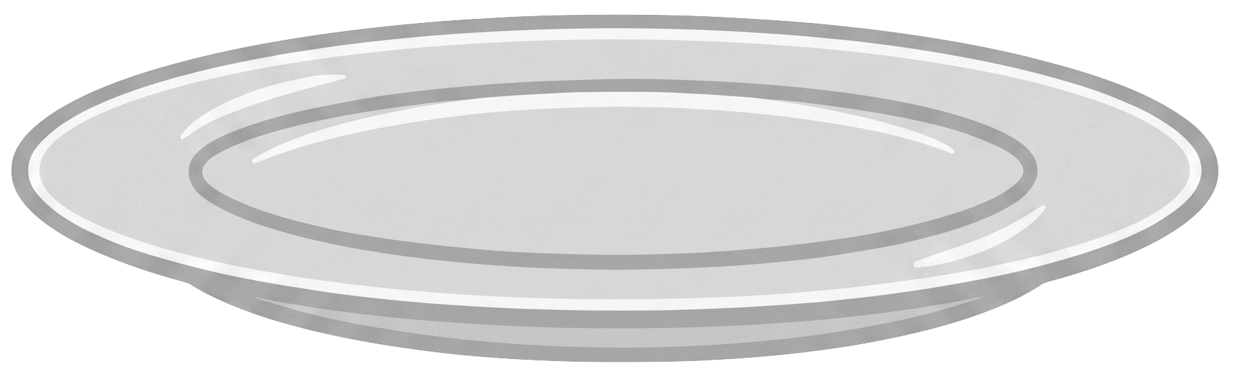
Sam has 5 cookies.

Slide 3
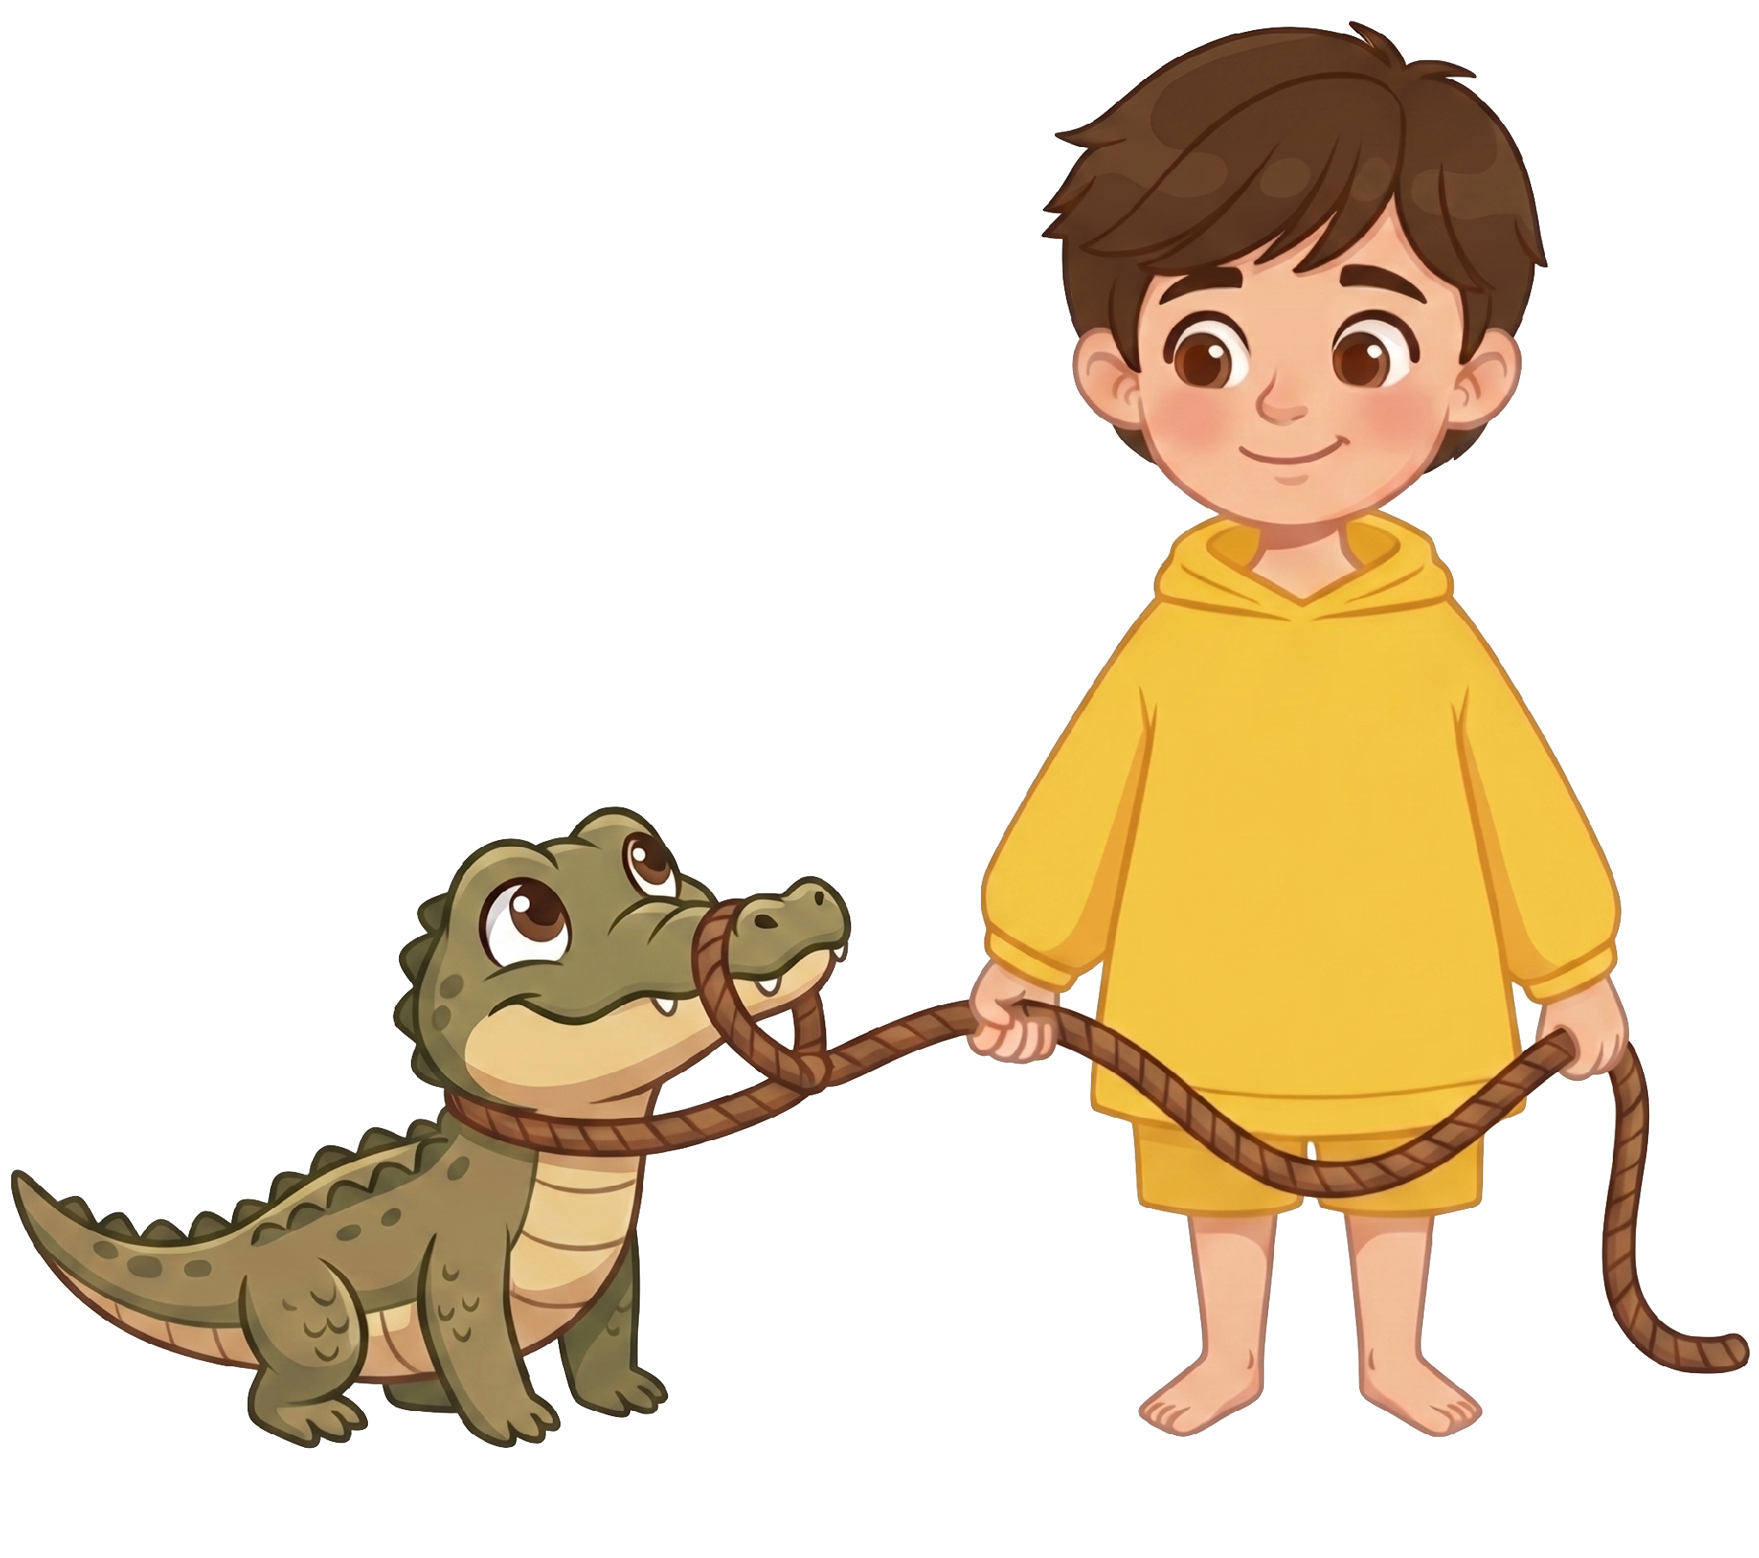
Sam has an alligator.

Slide 4
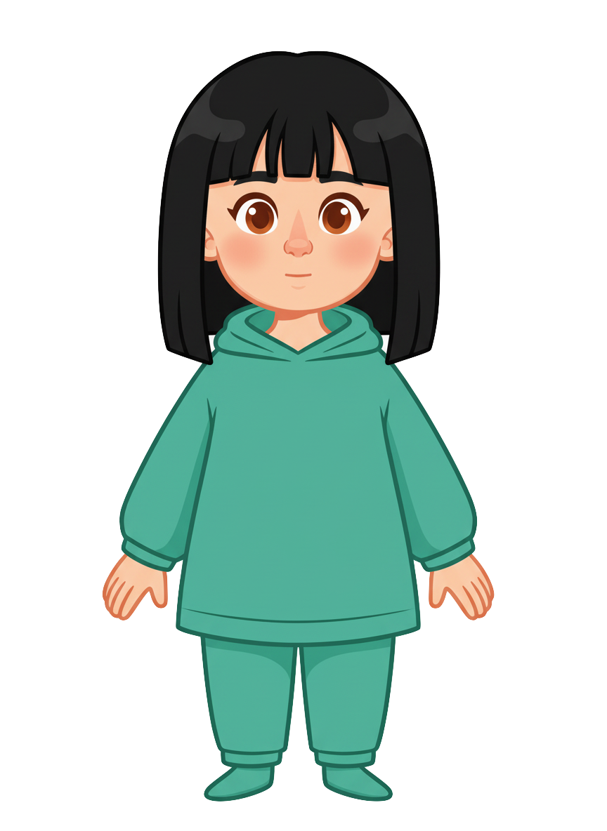
This is Ella.

Slide 5
Ella has 2 cookies.

Slide 6
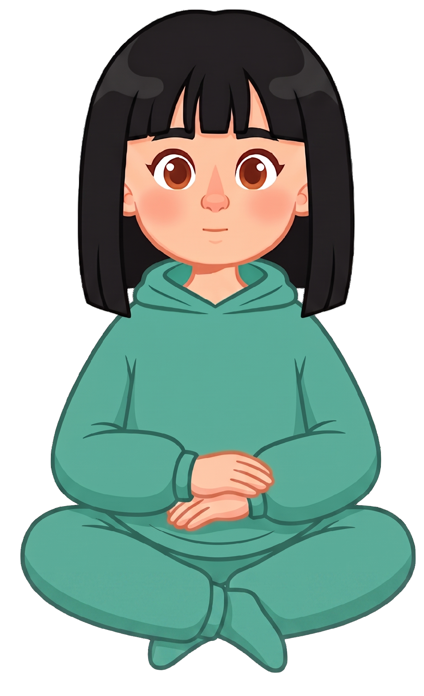

Sam is walking his alligator.

Slide 7
Ella stands up and sits her plate of cookies on the ground.

Slide 8
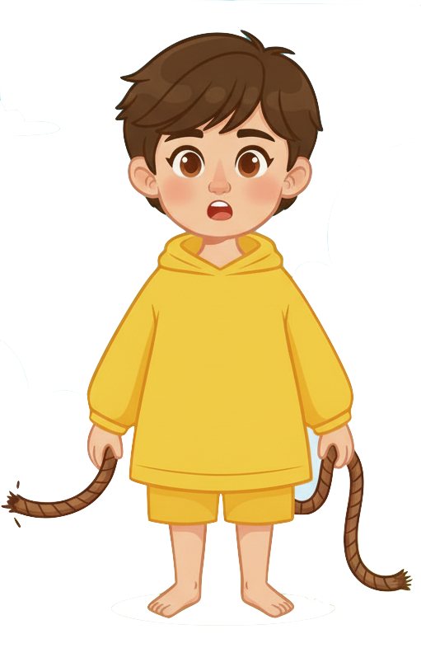
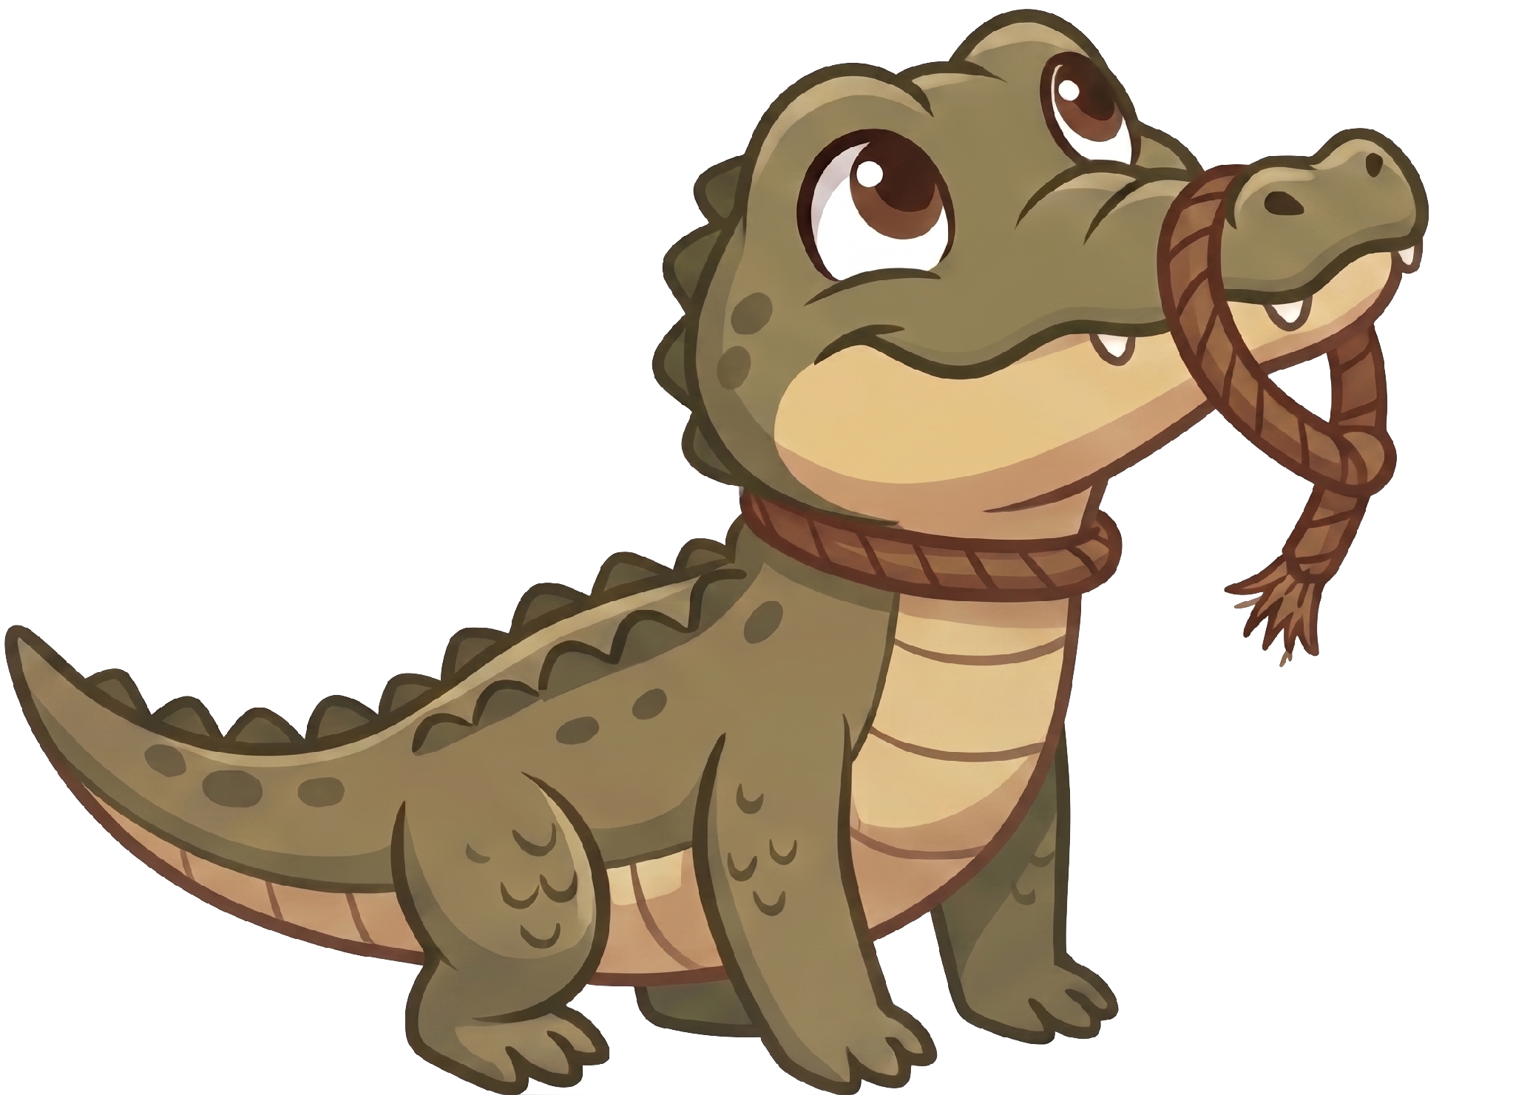
Oh no! The alligator breaks free from the leash!

Slide 9
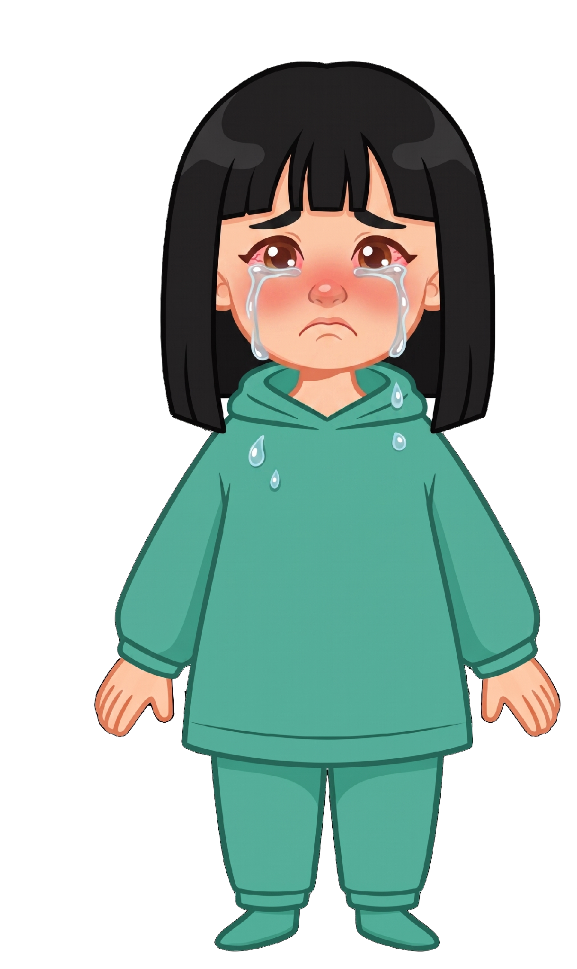
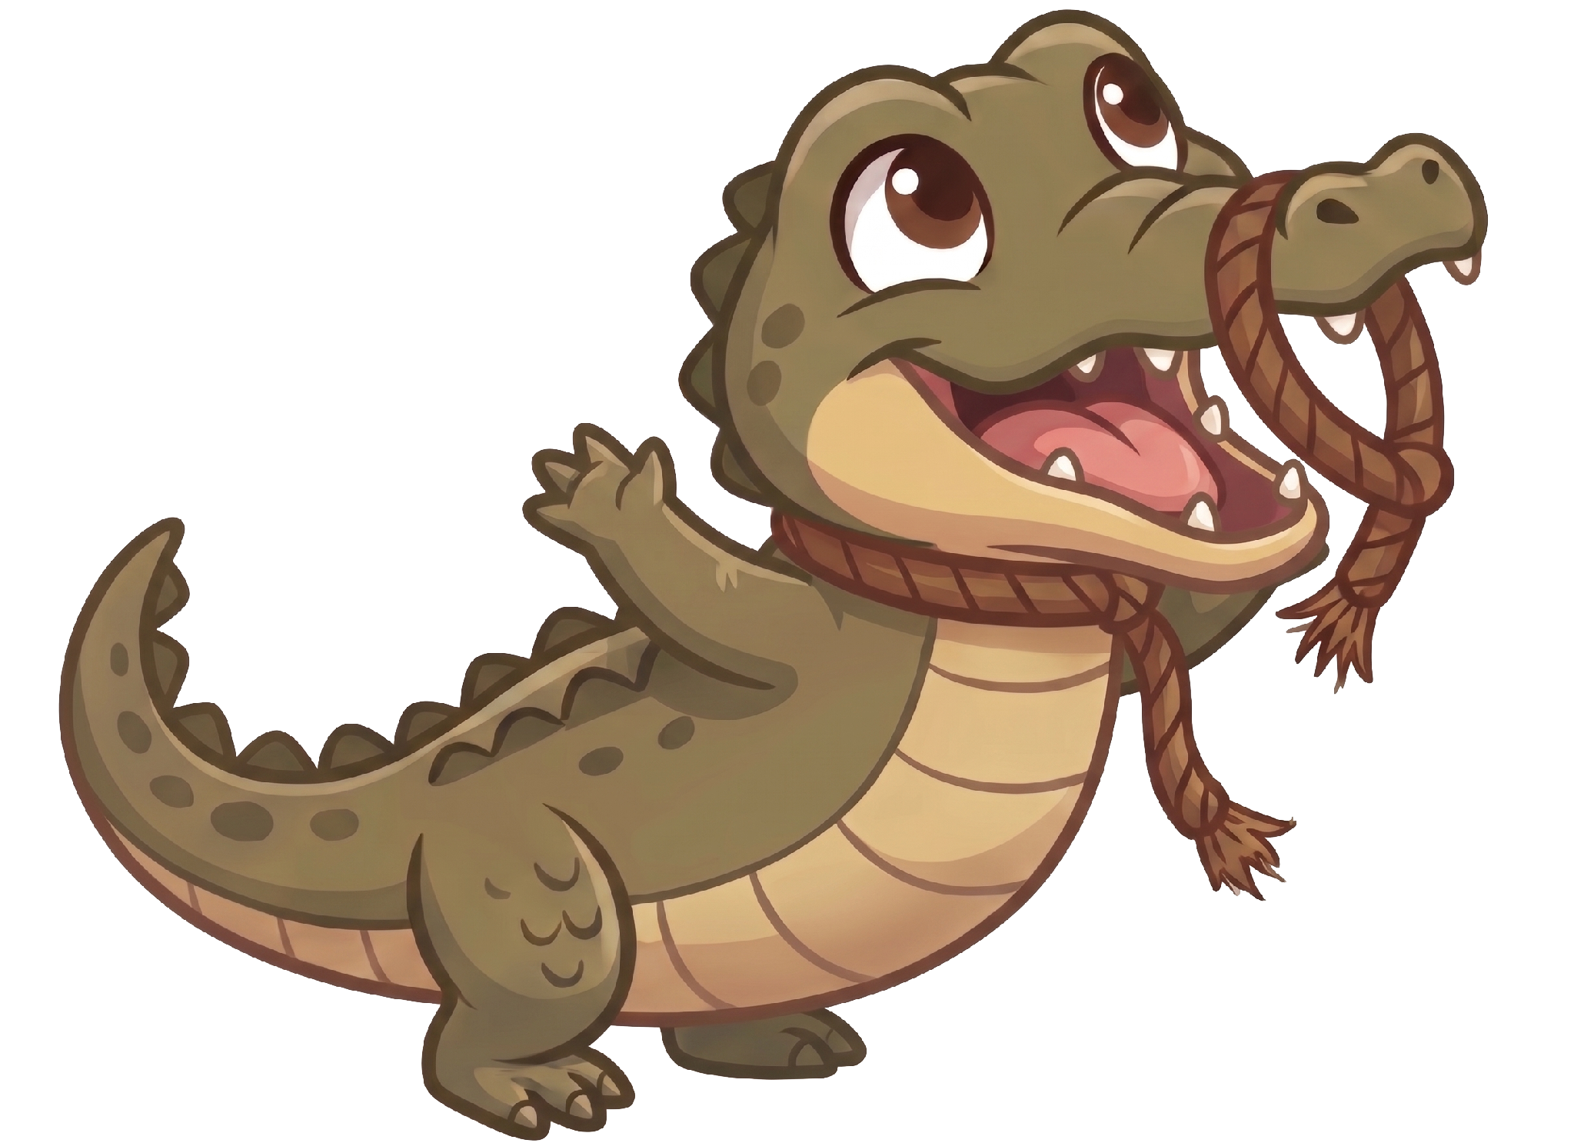
The alligator eats 2 of Ella’s cookies!

Slide 10
Sam still has 5 cookies. Ella now has 0 cookies.

